Slide 1

Food Delivery time prediction
Submitted by: Kishan Sai Venkata Vivek chandaluri
Reg no: 12223851

Slide 2
introduction
In the era of rapid digital transformation, online food delivery platforms like Zomato, Swiggy, and Uber Eats have revolutionized the way we order meals, making it easier than ever to enjoy food from our favorite restaurants. However, with growing order volumes and diverse delivery conditions, predicting accurate delivery times has become a major challenge for these services.
Our project, "Food Delivery Time Prediction," addresses this issue by leveraging machine learning techniques. We begin with exploratory data analysis to identify key trends and factors influencing delivery times, such as distance, vehicle type, and delivery partner details. Using various regression models, we predict delivery times more reliably, while employing model evaluation and error analysis to ensure accuracy and robustness in real-world scenarios. This helps improve customer experience by setting realistic expectations for when their food will arrive.

Slide 3
Abstract
With the rise of online food delivery platforms like Zomato and Swiggy, these services have become integral to how we dine in urban areas. However, as the number of deliveries grows and logistical challenges multiply, accurately predicting delivery times has become a significant hurdle. Our project aims to tackle this issue by analyzing food delivery data and developing a machine learning model to enhance the accuracy of delivery time predictions.
We start our analysis with exploratory data analysis (EDA) to uncover valuable insights into how factors like distance, vehicle type, order type, and delivery partner characteristics influence delivery times. Based on these insights, we implement various regression models, including Linear Regression, Decision Tree Regressor, and Random Forest Regressor, to predict how long deliveries will take. We train and evaluate these models using metrics such as RMSE, MAE, and R² to ensure they perform accurately. Ultimately, this project showcases how data-driven approaches can improve operational efficiency in food delivery services, leading to more reliable delivery time estimates and, in turn, greater customer satisfaction and service quality.

Slide 4
Problem statement
As online food delivery services become increasingly popular, one of the biggest challenges they face is providing accurate delivery time estimates. Customers often feel frustrated when their food arrives later than expected, which can lead to dissatisfaction and ultimately hurt the business. Our project seeks to address this issue by developing a machine learning model that predicts how long it will take for food to be delivered.
To create this model, we consider a variety of factors that can influence delivery times. This includes the locations of both the restaurant and the customer, the characteristics of the delivery partner, and specific details about the order itself. We also take into account external influences like traffic conditions and weather, which can significantly impact delivery times. By analyzing these elements, we aim to provide more reliable delivery time predictions, enhancing the overall customer experience and satisfaction.

Slide 5
methodology
Our project takes a structured approach to develop a reliable food delivery time prediction system by combining data preprocessing, exploratory analysis, and machine learning techniques. Here’s a breakdown of the key steps involved:
Data Collection and Loading We sourced our dataset from Kaggle, which contains historical records of food deliveries. This dataset includes important attributes such as delivery partner details (like age and ratings), order type, vehicle type, and the latitude and longitude of both the restaurant and delivery locations. The actual delivery time serves as our target variable. We loaded this data into a Jupyter Notebook using Pandas, setting the stage for our analysis.
Data Preprocessing To ensure high data quality, we began by handling missing values and duplicates. We converted data types, particularly for date and numerical features, and standardized categorical data such as vehicle and order types. During feature engineering, we calculated the distance between the restaurant and the customer using geolocation coordinates and created additional derived features to capture key delivery characteristics.

Slide 6
Exploratory Data Analysis (EDA) Next, we delved into exploratory data analysis to uncover delivery trends across various factors, including vehicle types, delivery partner profiles, and distance ranges. We visualized the distributions of key features using histograms, boxplots, and heatmaps, which helped us identify relationships and correlations between these features and delivery times.
Predictive Modeling We then developed and compared several regression models to predict delivery times. We started with Linear Regression to establish a baseline, followed by a Decision Tree Regressor to capture non-linear patterns, and finally a Random Forest Regressor to enhance accuracy through ensemble learning.
Evaluation and Testing To assess the performance of our models, we used metrics such as Root Mean Squared Error (RMSE), Mean Absolute Error (MAE), and the R² Score (coefficient of determination). Among the models, the Random Forest Regressor stood out, striking the best balance between bias and variance, and providing the most accurate predictions.

Slide 7
Result and analysis
Model | MAE | MSE | R2
Linear Regression | 5.62 | 49.15 | 0.43
Decision Tree | 3.96 | 26.97 | 0.69
Random Forest | 3.02 | 14.04 | 0.83
Table: Model Performance
Random Forest Regressor: Best performer (R 2 = 0.83).
Linear Regression: Limited by non-linear relationships (R 2 ≈ 0.43).
Decision Tree: Overfitting observed (high train score, low test score).

Slide 8
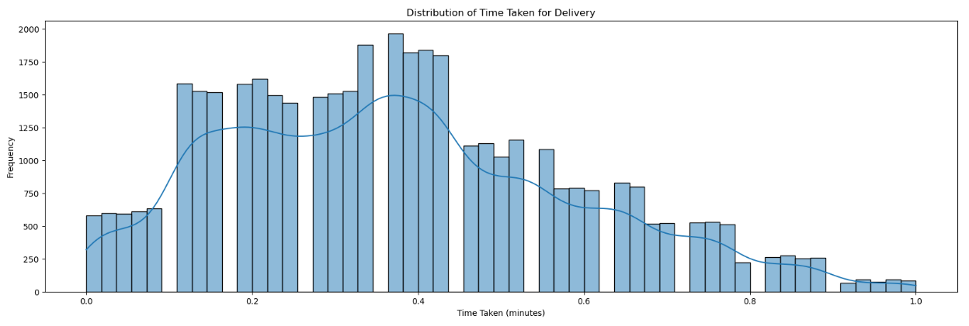
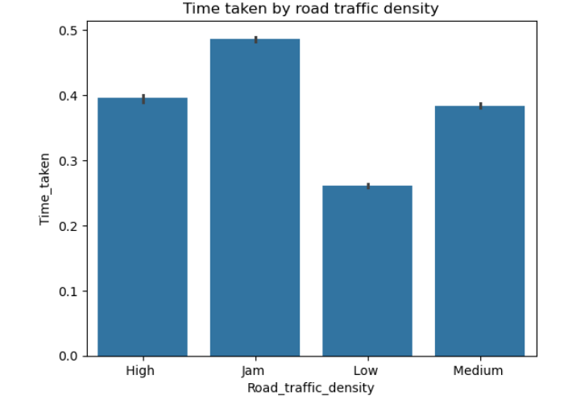
Fig 1: The histogram shows the distribution of delivery times, with most deliveries taking between 0.2 and 0.4 minutes.
Fig 2: Higher road traffic density (Jam) is associated with the longest delivery times, while low density results in the shortest times.

Slide 9
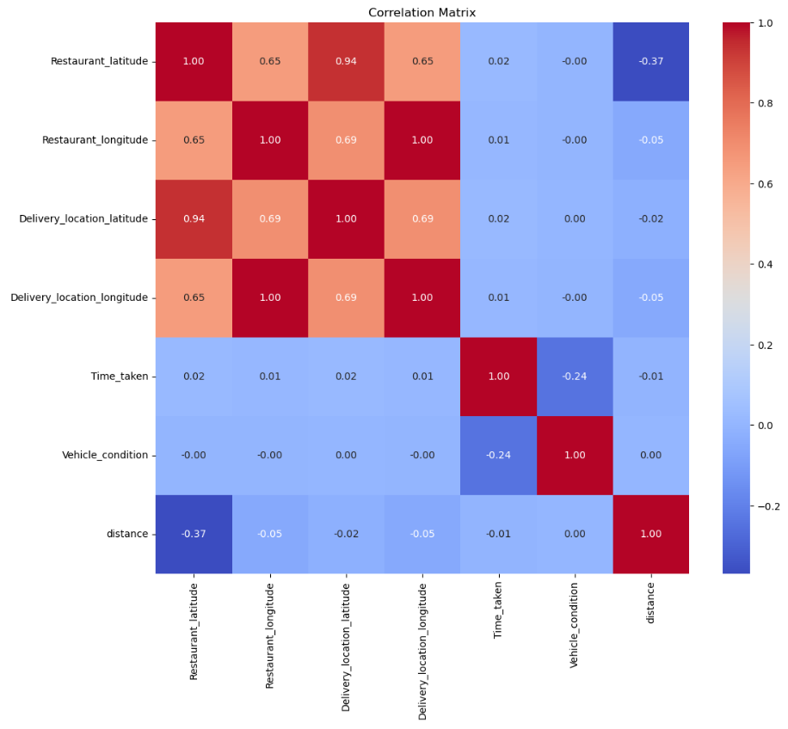
Fig 3: The correlation matrix indicates strong positive relationships among location and restaurant variables, a moderate positive correlation between distance and vehicle condition, and a weak negative correlation between distance and restaurant latitude.

Slide 10
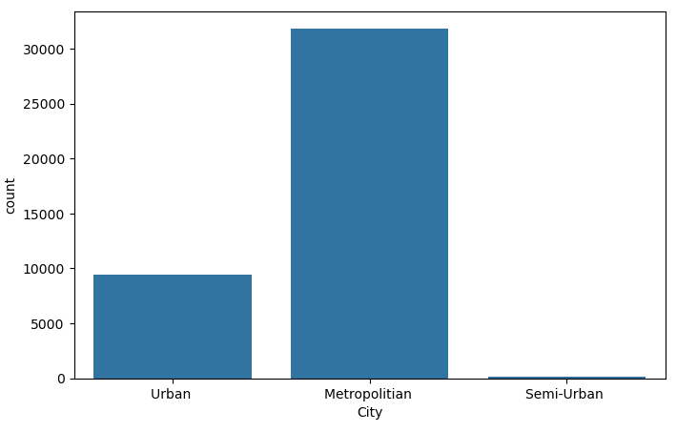
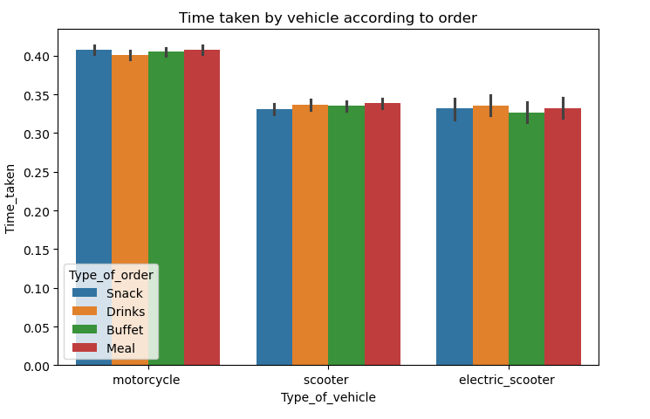
Fig 4: The bar chart shows that the Metropolitan city has the highest count, followed by Urban, and Semi-Urban has the lowest.
Fig 5: The chart shows that for all vehicle types, snacks take the longest time and meals the shortest, with slight variations depending on the vehicle type.

Slide 11
conclusion
This project successfully showcases how machine learning techniques can tackle a significant operational challenge in the food delivery industry: accurately predicting delivery times. Among the various models we tested, the Random Forest Regressor stood out, achieving a strong balance between training and testing accuracy, making it the most effective choice for our needs.
In contrast, Linear Regression proved to be too simplistic, failing to capture the complex, non-linear relationships between variables like delivery distance, vehicle type, and partner characteristics. While the Decision Tree Regressor performed well on training data, it struggled with overfitting, which diminished its reliability when faced with unseen data. Through meticulous data preprocessing, exploratory analysis, and model evaluation, we established a solid framework for predicting delivery times based on historical data.

Slide 12
Thank You

